Slide 1


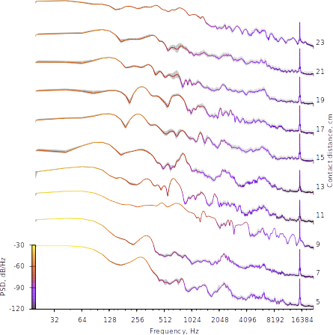
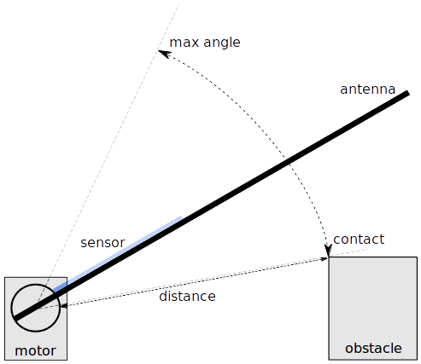
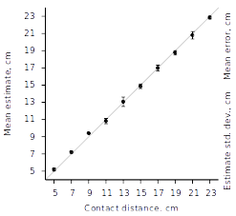
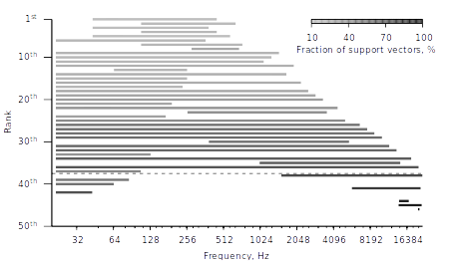
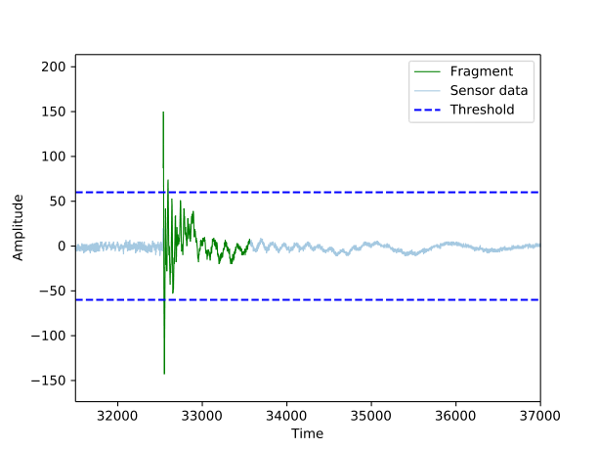
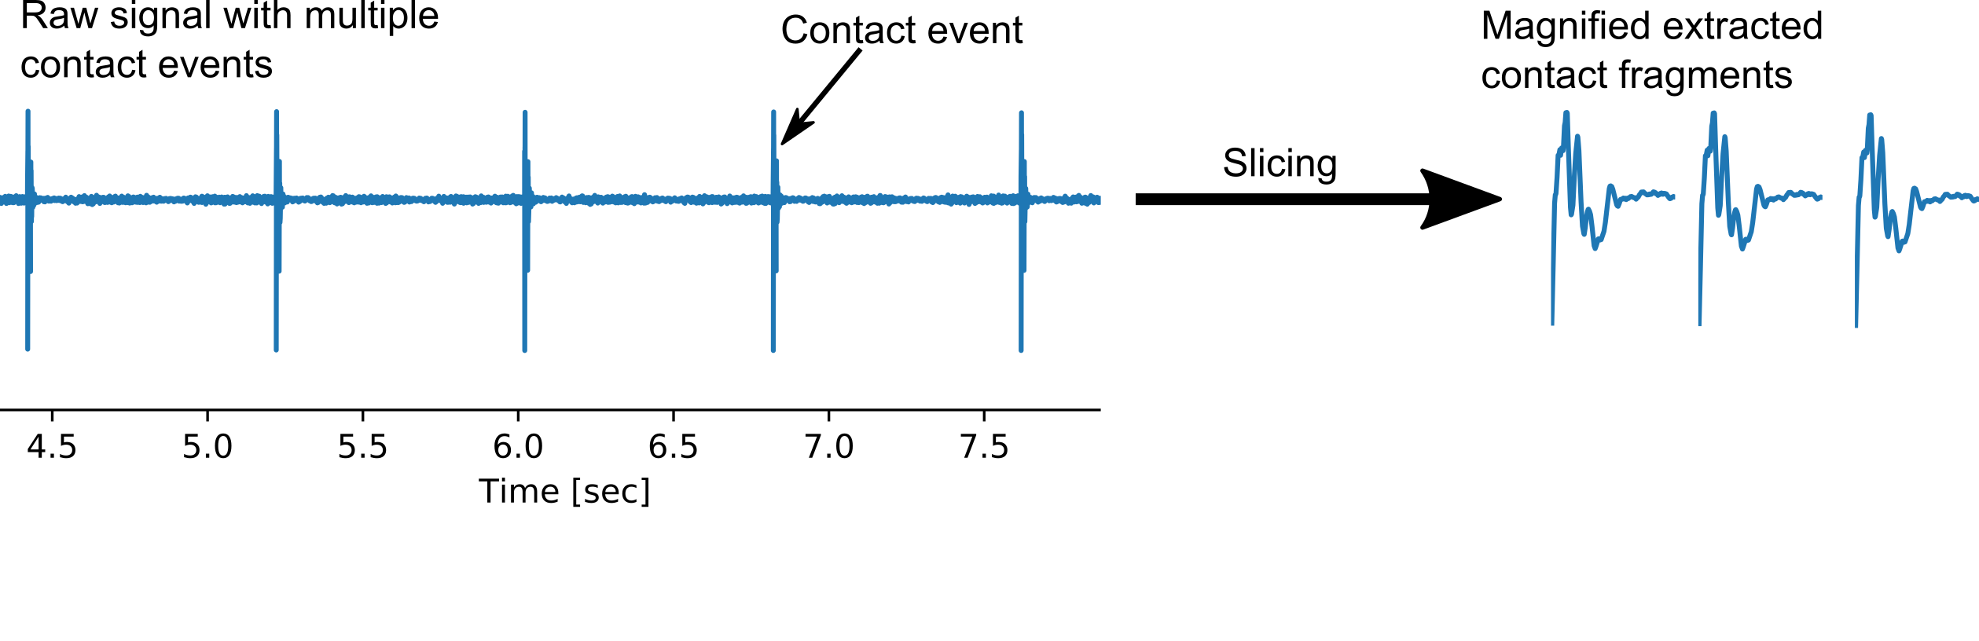
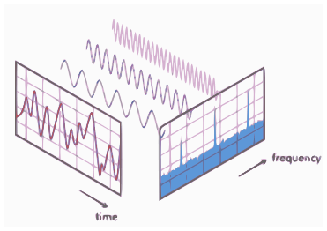
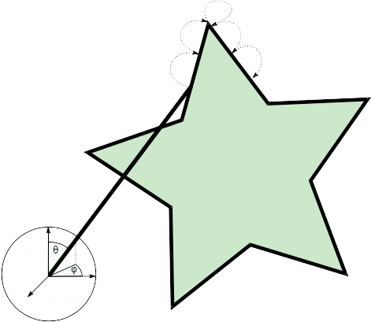
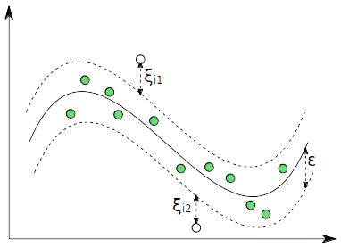
Graduate School Research Retreat
29th of November – 30th of November 2010
Graduate School Research Retreat
29th of November – 30th of November 2010
Department of
Biological Cybernetics
Toward a biomimetic Johnston’s organ for touch localization
Thierry Hoinville, Rüdiger Wehner and Holk Cruse
thierry.hoinville@uni-bielefeld.de
Introduction
Results
Most insects utilize a pair of antennae to sense their near-range environment. When blindfolded these insects are still capable of climbing obstacles and finding footholds for their front legs using their antennae [Dürr01]. Different types of mechanoreceptors present in each antenna, are involved to perform this kind of orientation. One of these receptors - the Johnston's organ - is correlated to the sensing of antennal vibrations [JC96]. As vibrations are characterized by their amplitude, frequency and phase, all further information about the origin of the vibration is encoded in these properties. This includes forces applied to the antenna on movement or on a contact with another object. Prior approaches to construct a biomimetic antenna have proven, that vibration characteristics can be exploited to estimate a position of a contact on the antenna or material properties and texture of any touched object [KM04]. Depending on the sensor, a broad range of frequencies can be used but in order to minimise latency, higher frequency bands are preferable. Hereinafter we present our artificial biomimetic antenna that mimics the function of the Johnston’s organ for touch localization.
Power density spectra
Mean spectra from 50 contacts per distance
Consistent shape per distance
Different in between distances
→ Distribution of frequency power depends on the contact position on the antenna
Suitable input for the SVR → dependency alread visible
Experimental setup
Experimental Setup
Polyacrylic tube as the antenna
Piezoelectric sensor to pickup vibrations
Servo-motor Dynamixel XL-320 to drive the antenna up and down
Metal socket as the obstacle
Unit gain voltage buffer circuit for high impedance to low impedance conversion
Signal gets recorded (at 44kHz) and stored
Contact detection
The incoming signal gets monitored
On transgression of a static threshold value, a contact is detected.
Contact recognition is deactivated for a short time after each detection to avoid counting rebounces
Support vector regression
Prediction error is below 0.5 cm
precision ~ 98%
Consistent predictions
Different regions were taken for training and testing of the model
Comparable results were obtained mainly in the frequency range of 40 – 10000 Hz
Antenna operation
Two-Phase-Oscillator:
Antenna is going down to induce a contact
On contact occurrence, the phase is changed to upward movement
When the motor reaches a maximum angle the phase is inverted and the steps are repeated
When a predefined number of contacts got detected the oscillator stops
R² Score
95%
Analytical methods
Conclusion
Information about the position of contact on the antenna is encoded in the vibration frequencies
A broad band of frequencies get influenced by a contact
Mainly the lower part of the spectrum encodes exploitable distances information
(up to ~ 10 kHz)
Support vector regression results in precise predictions for the contact distance
Even small frequency bands like 280 – 690 Hz are sufficient to get a score of > 99%
More complex tasks are now possible i.e.
    Contour sampling from antenna deflection
    angle + distance information
    Material analysis
    Orientation in complete
    darkness
Much lower sampling rates are sufficient, so
no professional interfaces and sensors are
needed
Power spectral density calculation (Welch's method)
Applied on every extracted region
Returns spectrum of frequency powers
Resolution depends on sampling rate of the input signal
Support vector regression (SVR)
machine learning approach for regression
Input: Region of frequency spectrum
Output: Distance in cm
finds ε-hypertube minimizing the loss
function
Different regions were taken for training
and testing the model
Source: https://en.wikipedia.org/wiki/Fast_Fourier_transform
[Dürr01] Dirks J., Dürr V., (2011) Biomech stick insect antenna: Damping properties, JMBBM V 4 I 8, pp. 2031-2042
[JC96] Sonja J., Andrej C., (1996) MechRezeptors: Johnston's organ, PA V 431 nr. 6. pp. R281-R282
[KM04] Kim DE, Möller R (2004) A biomimetic whisker, MIT Press, Conf. on the Simulation of Adaptive Behavior, pp. 140-149
Biological Cybernetics, University of Bielefeld: www.uni-bielefeld.de/biologie/Kybernetik/index.html

